Slide 1



Traffic Sign Detection
Name : Swapnil Ghosh
Roll : 001911001067
Department : Information Technology
Year : 4th
Semester : 1st

Slide 2
Traffic Sign Importance
Traffic signs provide valuable information to drivers and other road users.
It help’s to communicate messages to drivers and pedestrians so that no. of accidents can be reduced.
Traffic Sign helps in synchronization between vehicles.

Slide 3
GTSRB Dataset
This dataset consists of more than 50 thousand labeled images.
All Labeled images are categorized into 43 different types of traffic signs.
All the Labeled Traffic Signs Image are taken from the Germany streets and roads.
Link to the dataset: https://www.kaggle.com/datasets/meowmeowmeowmeowmeow/gtsrb-german-traffic-sign

Slide 4








































43 Different Type of Traffic Signs

Slide 5
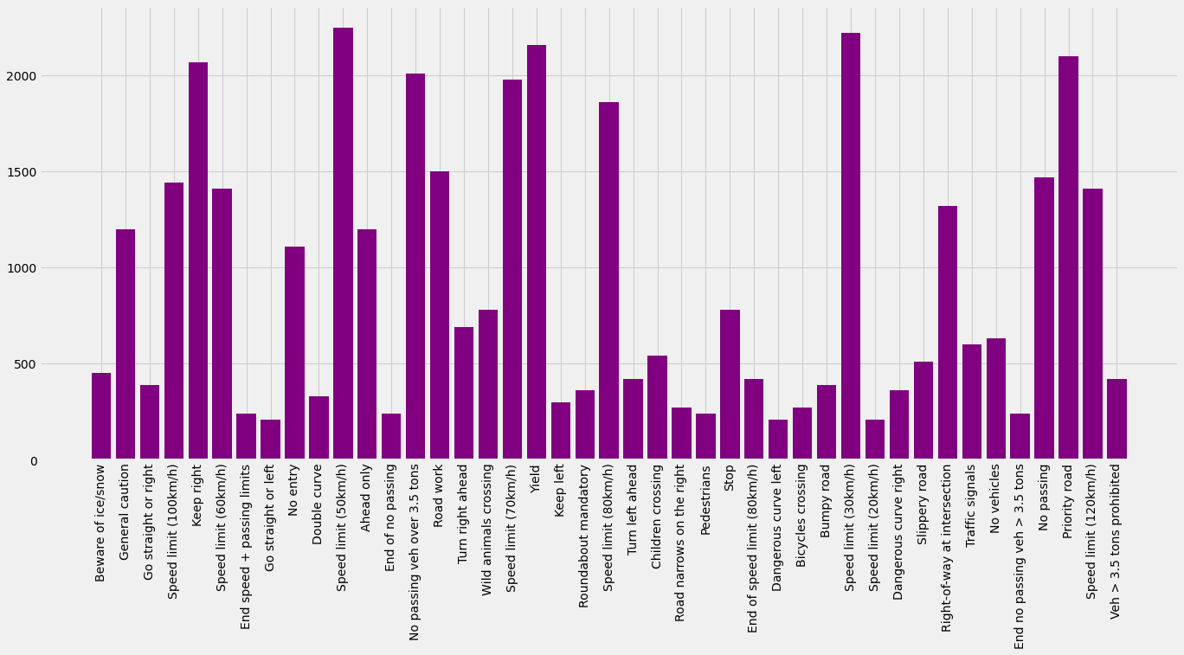
Traffic Sign Type vs Frequency Count

Slide 6
Classification Algo Determination
There are several type of supervised classification algorithm, we have to choose the most efficient algo meeting our current needs.
For Classification we can use the followings :
. . . .
Artificial Neural Network
( ANN )
Convolutional Neural Network
( CNN )
Recurrent Neural Network
( RNN )

Slide 7
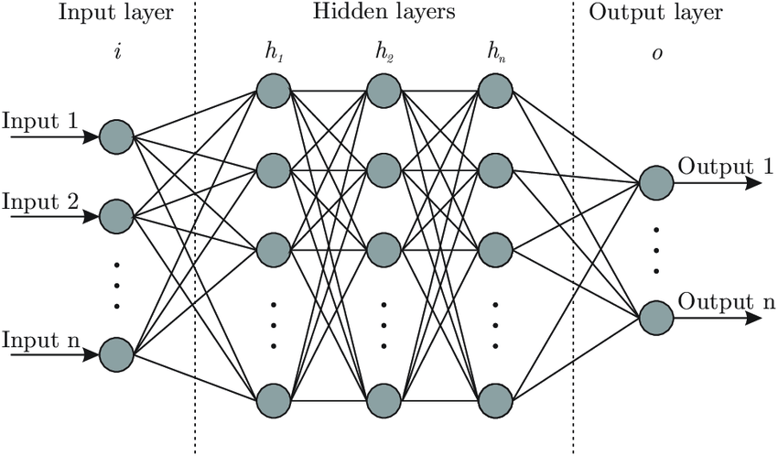
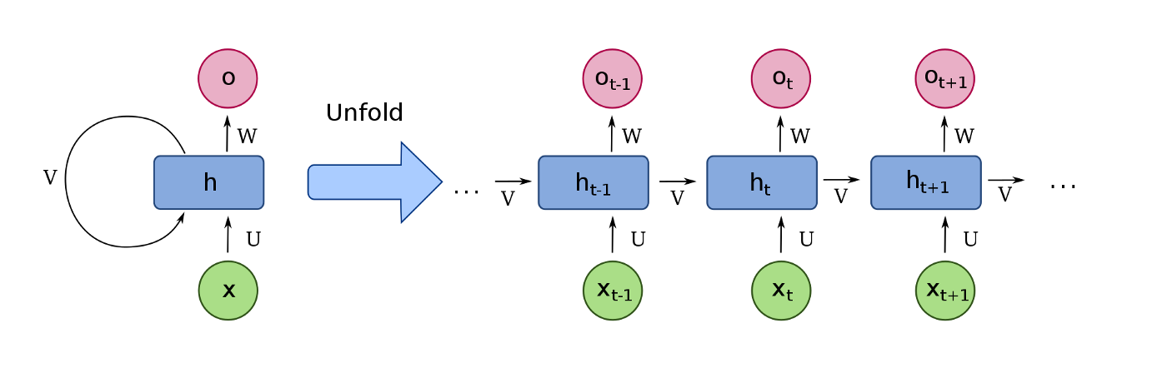
Why Not ANN ?
When the input to ANN is an image then the no. of trainable parameter (weights + biases ) increases with the size/ dimension of the image ,i.e., computation time increases.
Loss of Spatial Information b/w the pixels.
Why Not RNN ?
When an input to RNN is sequence of image, then dependencies b/w the image is considered, but in our case there is no dependencies in two different traffic sign image.

Slide 8
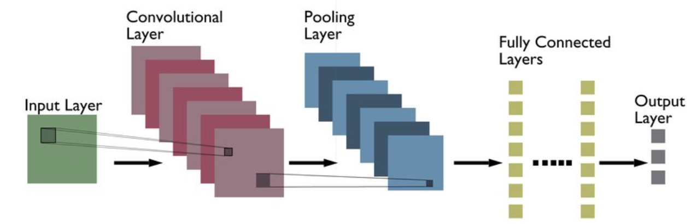
Why CNN ?
Number of trainable parameter doesn't depends on the input image dimension.
Automatic feature extraction.
Best suited for image data.

Slide 9
CNN Model
Model Diagrammatic View
Image 30x30x3
MaxPool2D
Conv2D, 512, 3x3, relu, same
Dense, 1024, relu
MaxPool2D
MaxPool2D
Dense, 4096, relu
Dense, 43, softmax
Conv2D, 264, 3x3, relu, same
Dropout(0.4)
Dense, 8192, relu
Conv2D, 512, 3x3, relu, same
Batch Normalization, Dropout(0.3)
Conv2D, 128, 3x3, relu, same
Flatten
Batch Normalization, Dropout(0.3)
Batch Normalization

Slide 10
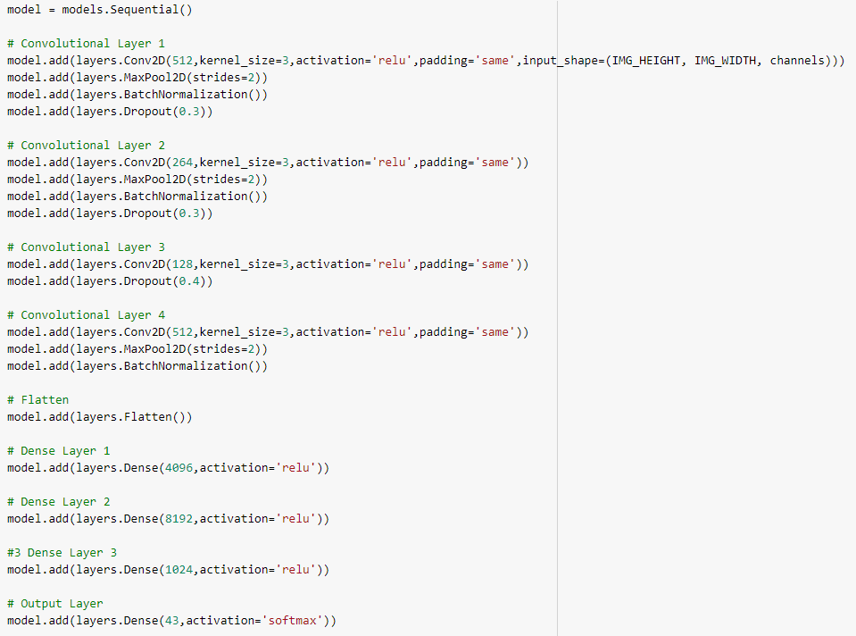
Model Code Implementation

Slide 11
Image Pre-processing
To achieve a good accuracy on testing data image pre-processing plays an important/ crucial role.
As a step for image preprocessing we are performing the following methods :
Image Normalization
Data Augmentation

Slide 12
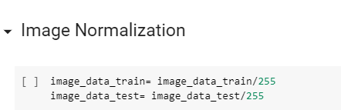
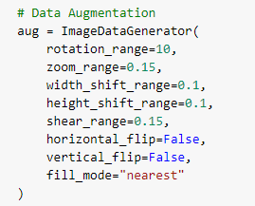
Image Normalization
All the values of pixel after normalization lies between 0 and 1.
Which eventually helps in minimizing loss function faster.
Therefore training time reduces and convergence is achieve faster.
Data Augmentation
In Data Augmentation we generate new data from the existing data, by varying brightness, cropping, zooming, rotating, ……
Using Data Augmentation we reduce over fitting as the dataset size increases.
Model during training adapt with various scenario of same object .

Slide 13
Methods Used To Overcome Overfitting
Dropout Layer
Data Augmentation
In dropout we remove random node based on dropout ratio (p) in each layer.
It helps us to reduce interdependence learning among the neurons.
( mentioned previously )
Early Stopping
It helps stop training once the model performance stops improving on validation dataset, thus helps model not to get overfitted.

Slide 14
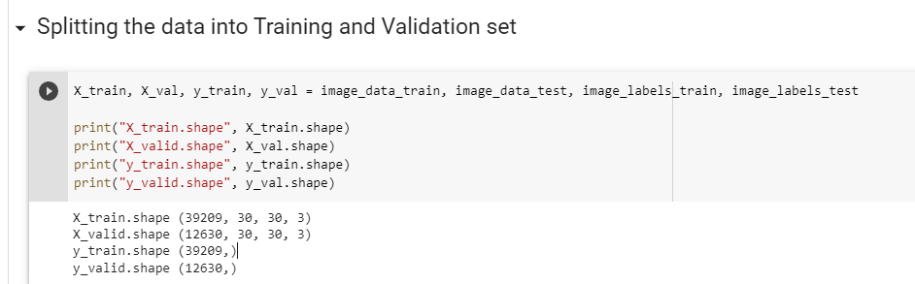
Training Of Model
We training the model with 39, 209 labelled images and we are validating the accuracy of the model using 12,630 images.

Slide 15

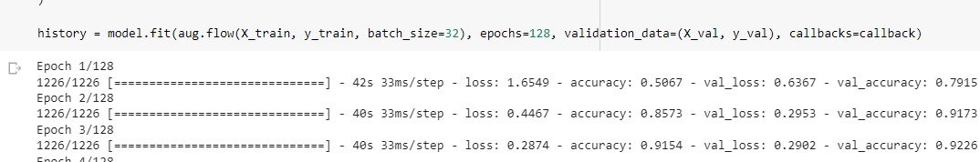
Our Loss function is categorical cross entropy as it’s a multiclass classification problem .
Our main objective is to minimize the loss function using Gradient Descent with Momentum approach ( Optimizer= Adam ).
We are setting max no of epochs to 128, our model stops before hand due to early stopping ( no more effective update) .

Slide 16
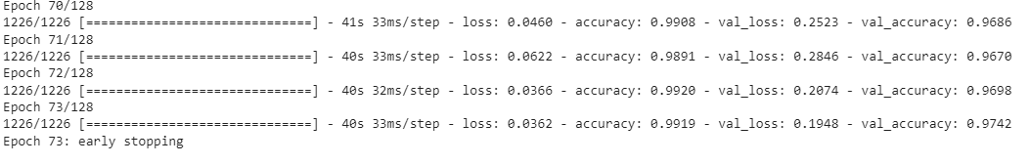
After few epochs ,
Stopping at 73 epoch because of early stopping.
Google Colab live link :
https://colab.research.google.com/drive/1S-KXjPALqdU0TbY2l7D9GgxJ3GjhQwDC?usp=sharing

Slide 17
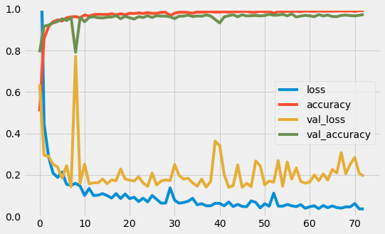
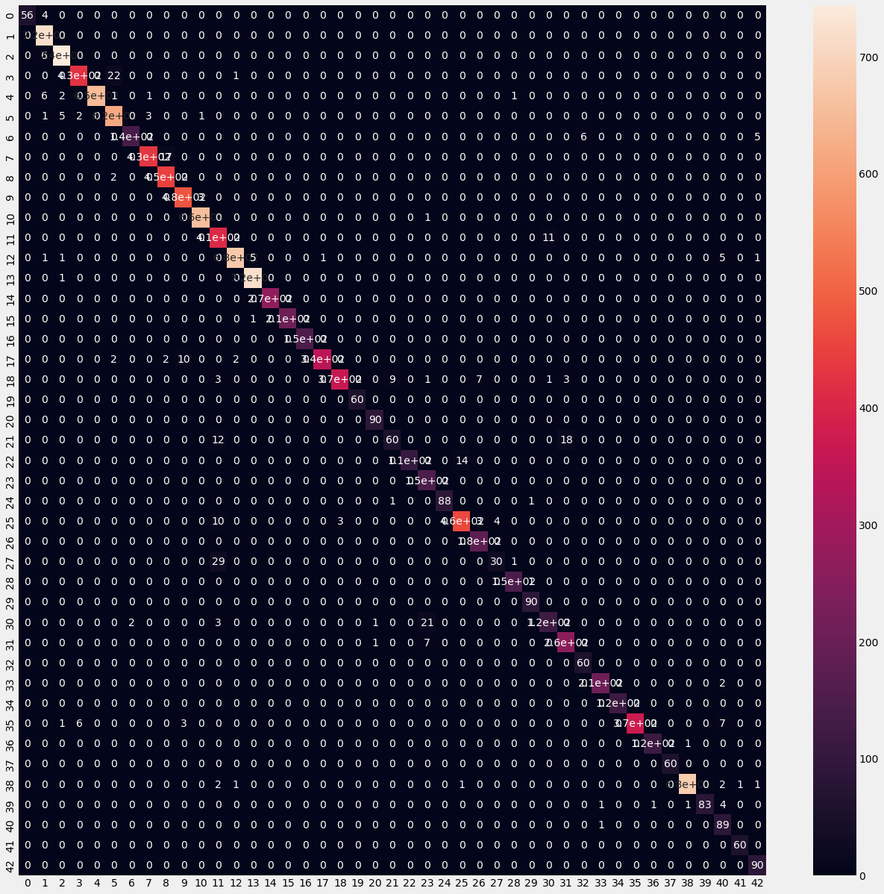
Accuracy
Model achieved a training accuracy of 99.19 %
and validation accuracy of 97.42 % .
Bias Variance Tradeoff
Confusion Matrix

Slide 18
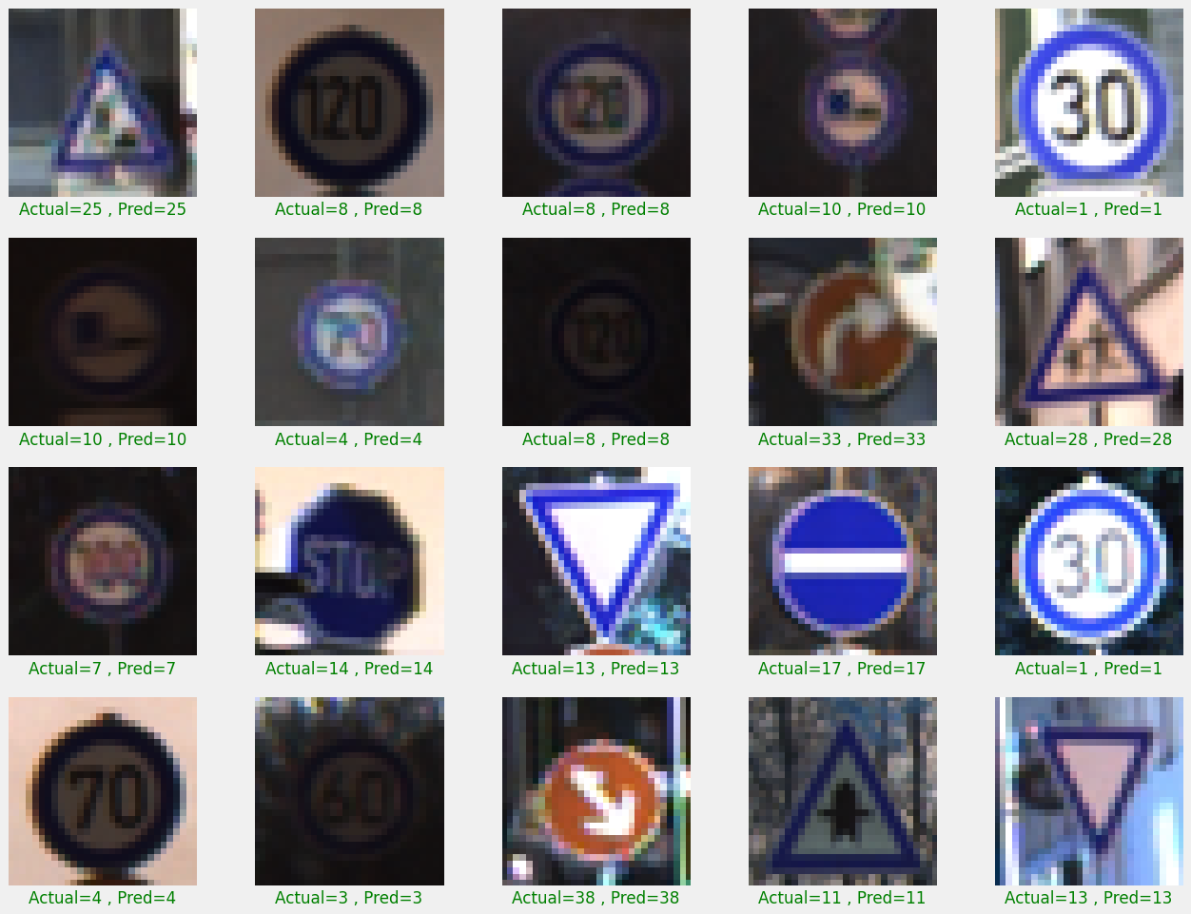
Prediction on Random Test Images

Slide 19
Future Goals
In the coming future I would try to use object detection for real-time classification of road symbol and feed that image to our trained model to classify type of traffic sign it is.
I will try to embed this model to car’s software along with camera to help the driver of the car to detect type of traffic sign easily.

Slide 20
THANK YOU

